Slide 1

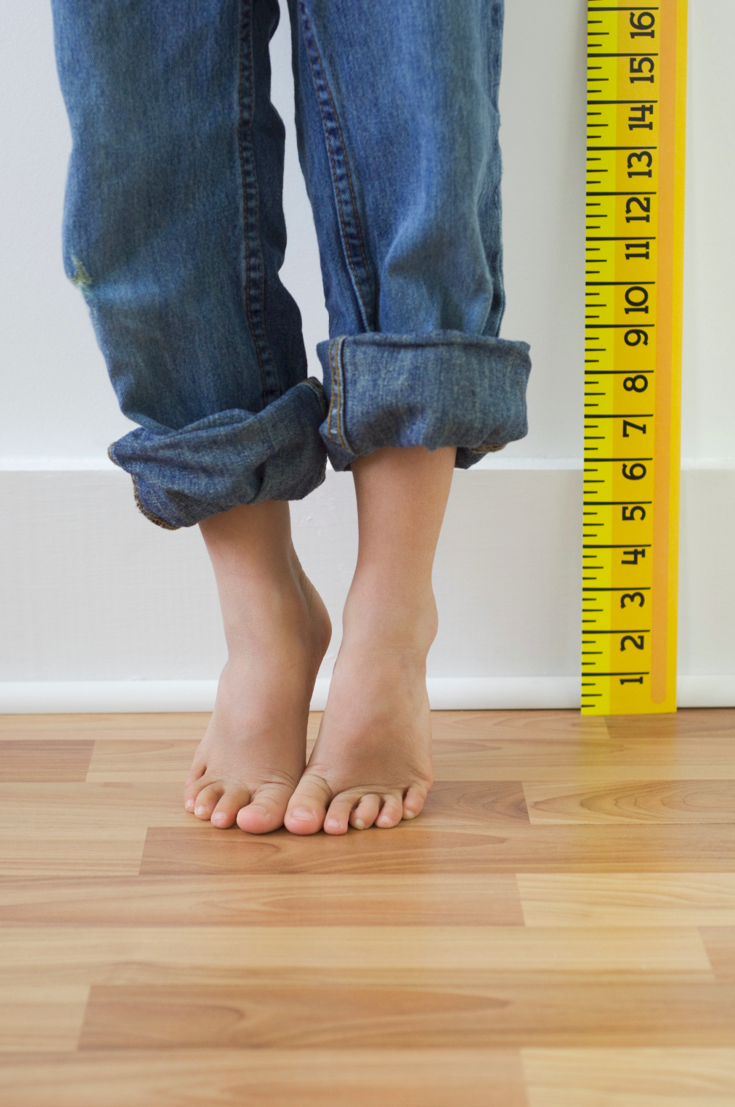

A Genome Wide Association Study to Identify Loci Associated with Human Height
Samuel Moijueh Dec. 8, 2014 BS 845 Applied Stats Modeling

Slide 2
Presentation Overview
Background
Methods
Results
Limitations
Summary

Slide 3

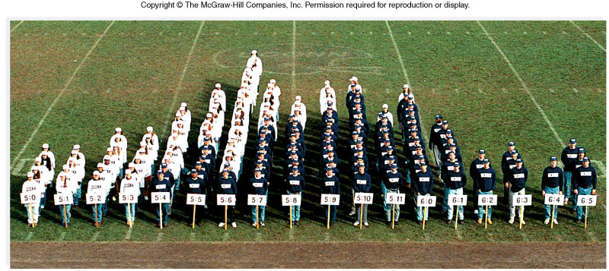
How much of human height is genetic?
Human height is a complex polygenic trait, difficult to predict
There are currently no genetically rigorous models used to predict a person’s height

Slide 4

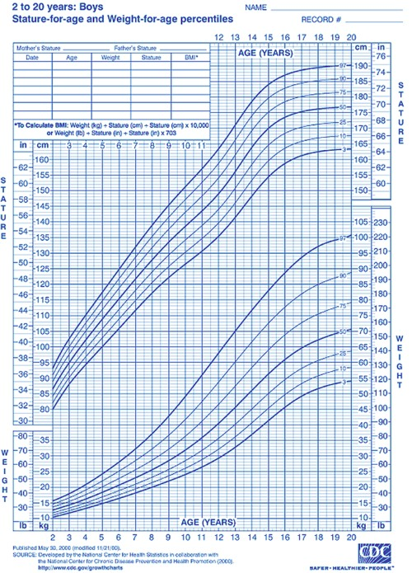
How much of human height is genetic?
Human height is a complex polygenic trait, difficult to predict
There are currently no genetically rigorous models used to predict a person’s height

Slide 5
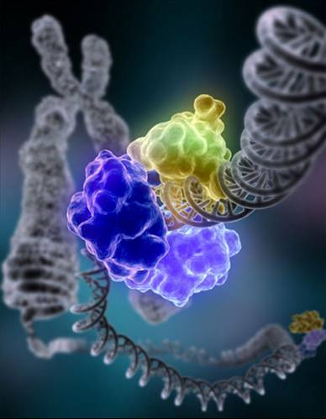


Motivation
Embryonic Screenings
crime scene forensics
Classification of polygenic diseases

Slide 6
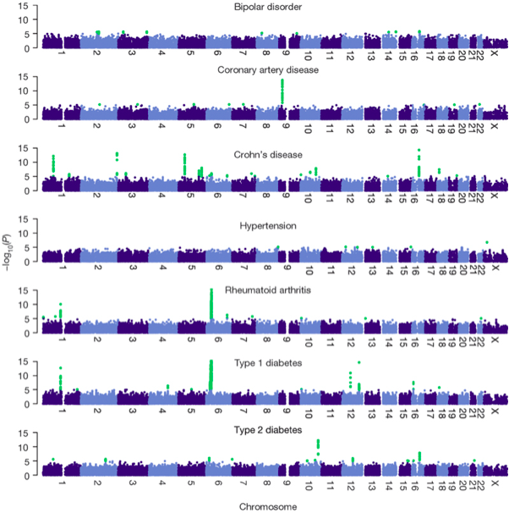
Genome Wide Association Study
Multiple Hypothesis
tests performed to
identify causal single nucleotide polymorphisms (SNPs)
that are statistically associated with human height

Slide 7
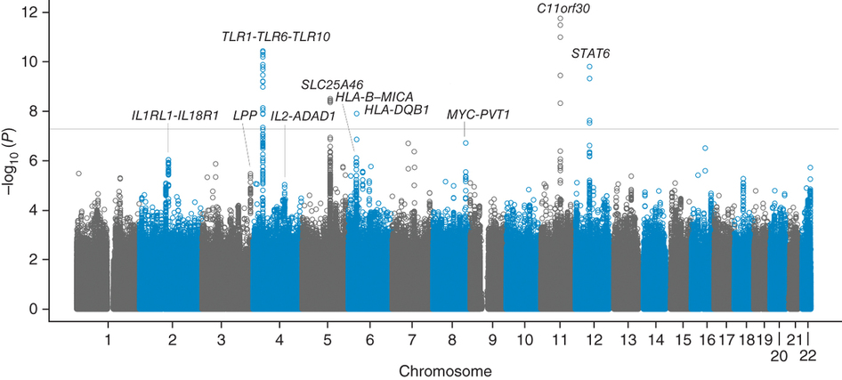
Genome Wide Association Study

Slide 8

Method
Curation: 313 individuals, SNP array data obtained from 23andme and FamilyTree
SNP genomic quality: Hardy-Weinberg equilibrium Chi Square Tests
Vectorization
Anova Dummy Variable Coding based on the MAF
Linear Regression Model

Slide 9
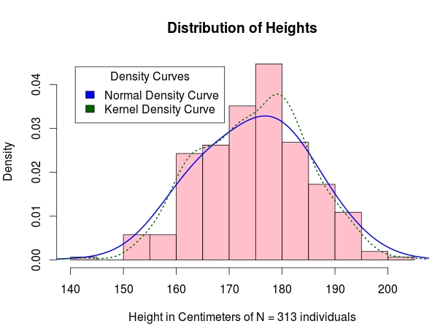
Methods (continued)
EIGENSTRAT: Principle Component Analysis to correct for Population Stratification
Check GWAS assumption of normality

Slide 10
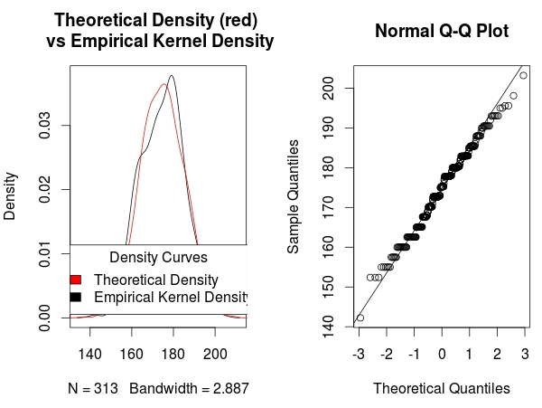
Methods (continued)
EIGENSTRAT: Principle Component Analysis to correct for Population Stratification
Check GWAS assumption of normality

Slide 11
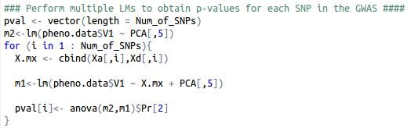
Methods
Linear Model of GWAS:

Slide 12
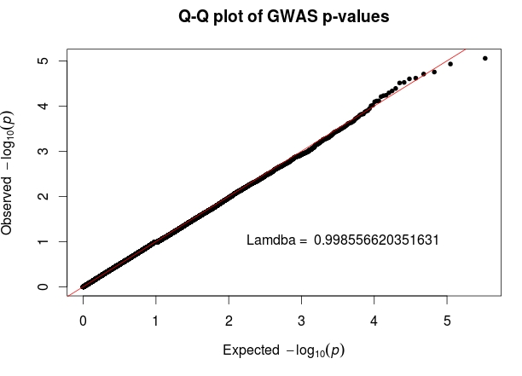
Results

Slide 13
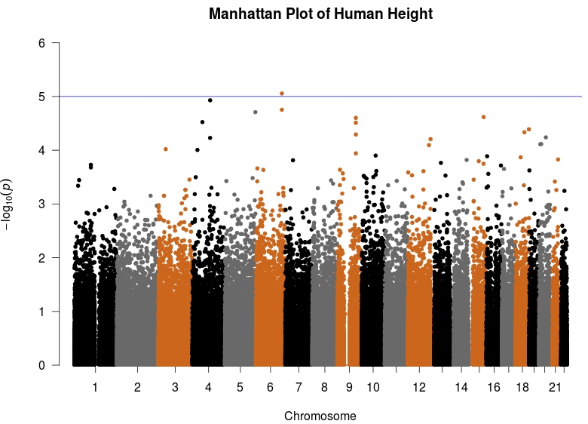
Results

Slide 14
Limitations
313 individuals, Low power study
Unable to account for common covariates; Individuals were missing AGE and SEX

Slide 15
Future Direction
Obtain a list of the top 500 significant SNPs and examine the data for Linkage Disequilibrium
Haplotype Analysis
Examine for Epistasis
map the combination of major and minor alleles for each nucleotide into a euclidean space, train an Support Vector Machine that and predict the height of users' class
Regional Gene Plot to visualize LD

Slide 16
Questions?

